Slide 1
Website Development Introduction to JavaScript
Neil Buckley
bucklen@hope.ac.uk
FML308B

Slide 2
Aims
Introduce JavaScript basics
Event handlers and functions
Show some working examples of JavaScript

Slide 3
JavaScript
Is an object-oriented scripting language
Used to make web pages interactive
Principle use: Client-side
Interpreted by browser
Possible to use it Server-side
Node.js and other technologies.
Can be used, but not covered this year.

Slide 4
JavaScript
Works with XHTML/HTML5
Embedded in the document
External file linked - .js extension
May not work in all browsers/settings
Different browsers interpret the code differently
Check as you develop
Use browser detection and browser specific code
Much less of a problem these days ☺
NOT Java
Event driven (responds to click, load, mouse events etc)
New version is object-oriented.

Slide 5
Uses of JavaScript
Window or Frame control
Image effects (e.g. rollover or movement)
Date information
Data validation
Forms
Performing calculations
CSS visibility or positioning
Plus more

Slide 6
JavaScript and Web Pages
Normally in the head, but can go in the body
Use <script> </script>tag
Use comment to hide from older browsers
JavaScript is case sensitive
Page elements need to be named to work with JavaScript
<input type=“text” name=“forename” id=“forename” />

Slide 7
How it works
JavaScript is event driven
i.e. we need something to happen (an event) before JavaScript will do anything
a web page loading is an event. This could be very useful

Slide 8
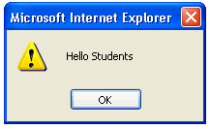
First example
<html>
<head> <title>My first JavaScript example</title>
<script language="javascript“ type="text/javascript">
<!--
alert(“Hello Students")
//-->
</script>
</head>
<body>
</body>
</html>

Slide 9
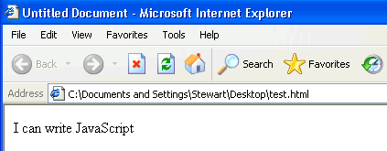
Second example
<html>
<head> <title>My second JavaScript example</title>
<script language="javascript“ type="text/javascript">
<!--
document.write(“I can write JavaScript”)
//-->
</script>
</head>
<body> </body> </html>

Slide 10
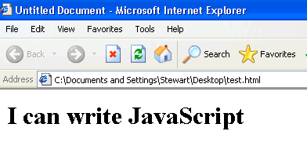
Third example
<html>
<head> <title>My third JavaScript example</title>
<script language="javascript“ type="text/javascript">
<!--
document.write(“ <h1> I can write JavaScript</h1> ”)
//-->
</script>
</head>
<body> </body> </html>

Slide 11
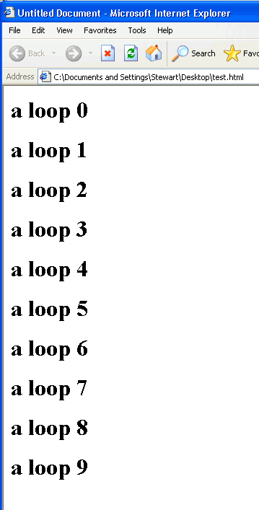
JavaScript is NOT a programming Language
<html>
<head> <title>My JavaScript loop example</title>
<script language="javascript“ type="text/javascript">
<!--
var i = 1;
for (i = 0; i < 10; i++)
{
document.write(" <h1> a loop " + i + "</h1> " )
}
//-->
</script>
</head>
<body> </body> </html>

Slide 12
Functions
re-useable pieces of code
don’t run straight away- they are called by other scripts
Eg
function openWin(url)
{
code goes here;
}
Called using the name of the function:eg openWin(‘studentPortal.html’);

Slide 13
Functions – two sections
<html>
<head> <title>Eg5 My first function</title>
<script language="javascript" type="text/javascript">
<!--
function julep()
{ var n = window.prompt("enter your name:","")
document.write("<h1>Hello again " + n + " </h1>")
}
//-->
</script> </head>
<body onLoad="julep()" >
</body> </html>

Slide 14
Why use functions
Web browsers will execute the JavaScript code before the HTML page loads
Sometimes you may not want the JavaScript to be executed until a specific time
You may want to use the JavaScript again and again
You may want several separate JavaScript scripts running on the same page

Slide 15
A simple function
function displayMessage()
{
alert("Hello World!");
}

Slide 16
To call a function
onclick = “functionname()”
onkeydown = “functionname()”
onkeypress = “functionname()”
onkeyup = “functionname()”
onmousemove = “functionname()”
21 Event Handlers in total.
http://www.w3schools.com/jsref/jsref_events.asp

Slide 17
Example
<form id="form1" name="form1" method="post" action="">
Enter Telephone Number
<input type="text"
name="telnum"
id="telnum"
onkeyup="checkNum()"/>
</form>

Slide 18
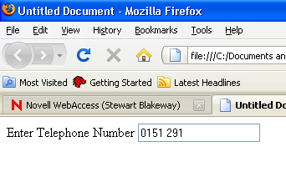
function checkNum()
pass
false
true
telephone
0151 291
last
7
function checkNum()
{
var pass = false;
var telephone = document.getElementById("telnum").value;
var last = telephone.length-1;
for (var x=0 ; x <= 9 ; x++)
{
if (x==telephone[last])
{
pass = true;
}
}
if (pass == false)
{
window.alert("You are only allowed to put numbers");
}
}
x
1
0
false
true
Index [ ] | 0 | 1 | 2 | 3 | 4 | 5 | 6 | 7
telephone | 0 | 1 | 5 | 1 |  | 2 | 9 | 1

Slide 19
Passing Arguments
Sometimes you will want to pass a value to a function

Slide 20
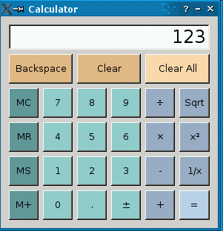
Seminar Example (passing arguments)
If 0 – 9 is pressed deal with the input

Slide 21
The HTML
<input name="Button1" type="button" id="Button1" value="1" onclick="getNum(1)" />
<input name="Button2" type="button" id="Button2" value="2" onclick="getNum(2)" />
<input name="Button3" type="button" id="Button3" value=“3" onclick="getNum(3)" />

Slide 22
The Function
function getNum(number)
{
document.form1.calcDisplay.value = (document.form1.calcDisplay.value + number);
}
Important
This does not perform an addition. It concatenates!

Slide 23
Seminar Example (passing arguments)
If divide, multiply, subtract or add is pressed deal with the input

Slide 24
The HTML
<input name="Buttonplus" type="button" id="Buttonplus" value="+" onclick="operator('+')" />
<input name="Buttonsub" type="button" id="Buttonsub" value="-" onclick="operator('-')" />

Slide 25
The Function
function operator(symbol)
{
var running_total = document.getElementById("running_total").value;
if (running_total == "")
{
document.form1.running_total.value =
document.form1.calcDisplay.value;
document.form1.calcDisplay.value = "";
document.form1.operator.value = symbol;
}
else
{
// next slide
}

Slide 26
else
if (document.form1.operator.value == "+")
{
document.form1.running_total.value = Number(document.form1.running_total.value) + Number(document.form1.calcDisplay.value);
document.form1.operator.value = symbol;
document.form1.calcDisplay.value = "";
}

Slide 27
Very crude?
Although the calculator works
lacks finish
polish
completeness
functionality
Can you do better?
Start thinking about your
design
functionality
To develop in your seminar, you can work in pairs.

Slide 28
Any Questions?
Next week?
Regular Expression
/^\w+([\.]?\w+)*@\w+([\.-]?\w+)*(\.\w{2,3})+$/

Slide 29
Javascript tutorial
http://www.w3schools.com/js/default.asp
More JavaScript Next Week
Rollovers
Form Validation
Dates

